Slide 1
Closure properties of Regular languages

Slide 2
Closure properties on regular languages are defined as certain operations on regular language which are guaranteed to produce regular language. Closure refers to some operation on a language, resulting in a new language that is of same “type” as originally operated on i.e., regular.
Regular languages are closed under following operations.

Slide 3
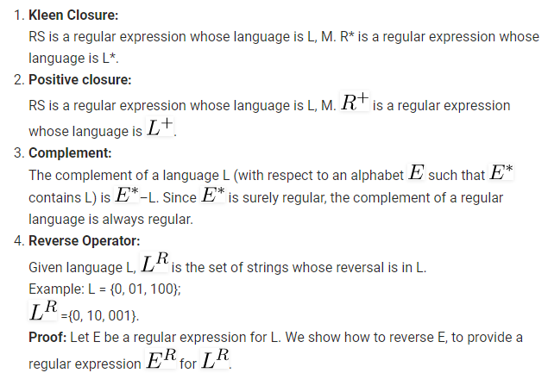

Slide 4
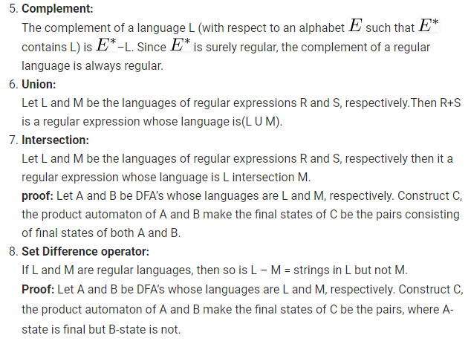

Slide 5
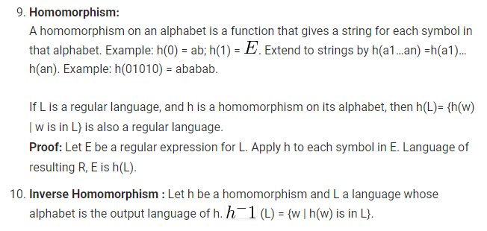

Slide 6
Decision Properties:
Approximately all the properties are decidable in case of finite automaton.
(i) Emptiness
(ii) Non-emptiness
(iii) Finiteness
(iv) Infiniteness
(v) Membership
(vi) Equality

Slide 7
These are explained as following below.
(i) Emptiness and Non-emptiness:
Step-1: select the state that cannot be reached from the initial states & delete them (remove unreachable states).
Step 2: if the resulting machine contains at least one final states, so then the finite automata accepts the non-empty language.
Step 3: if the resulting machine is free from final state, then finite automata accepts empty language.
(ii) Finiteness and Infiniteness:
Step-1: select the state that cannot be reached from the initial state & delete them (remove unreachable states).
Step-2: select the state from which we cannot reach the final state & delete them (remove dead states).
Step-3: if the resulting machine contains loops or cycles then the finite automata accepts infinite language.
Step-4: if the resulting machine do not contain loops or cycles then the finite automata accepts infinite language.

Slide 8
(iii) Membership: Membership is a property to verify an arbitrary string is accepted by a finite automaton or not i.e. it is a member of the language or not.
Let M is a finite automata that accepts some strings over an alphabet, and let ‘w’ be any string defined over the alphabet, if there exist a transition path in M, which starts at initial state & ends in anyone of the final state, then string ‘w’ is a member of M, otherwise ‘w’ is not a member of M.
(iv) Equality: Two finite state automata M1 & M2 is said to be equal if and only if, they accept the same language. Minimise the finite state automata and the minimal DFA will be unique.

